Slide 1
Vardi’s Law and Some Exceptions
The Gap between Data and Expression Complexity of Reasoning Formalisms
Georg Gottlob
University of Oxford
& TU Wien

Slide 2
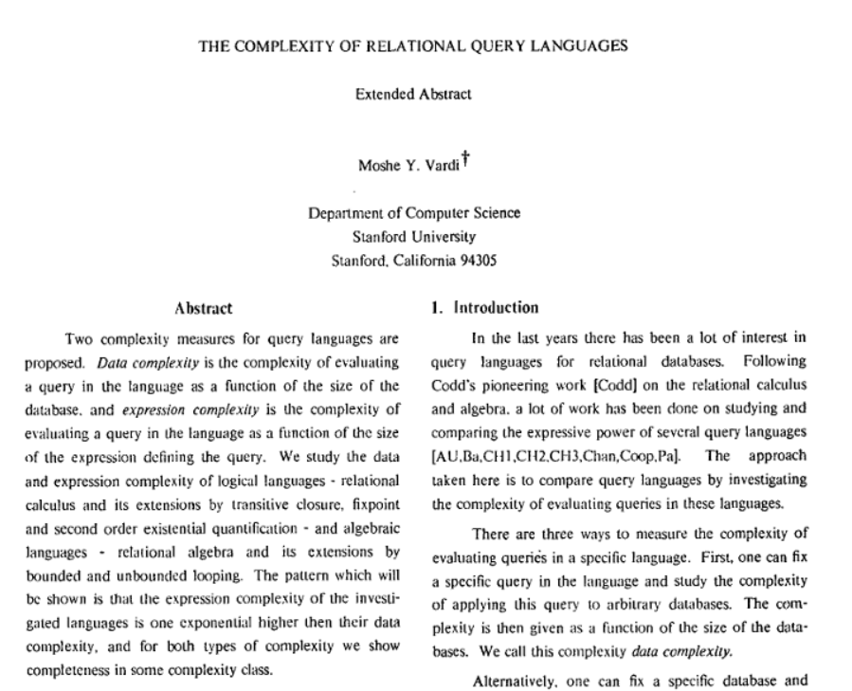
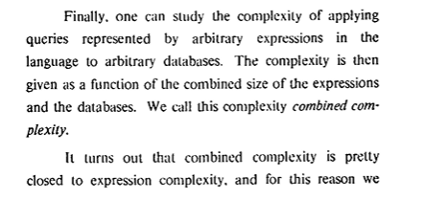
FUNDAMENTAL INSIGHT AND DEFINITIONS
Data Complexity
Expression Complexity (a.k.a. Program Complexity)
Combined Complexity

Slide 3

VARDI’S LAW
… This happens to be quite a typical pattern. The expression complexity of the investigated languages is
usually one exponential higher than the data complexity…
This is indeed very often so, but let us see some exceptions

Slide 4
CASE 1: Double-Exponential Gap
Language: Guarded Datalog[∃]
Semantics: Chase (possibly infinite)
Problem: Query-of-Tuple Problem (QOT)
reports(x,y) & consultant(y) → ∃z (emp(z) ∧ reports(y,z))

Slide 5
CASE 1: Double-Exponential Gap
Language: Guarded Datalog[∃]
Semantics: Chase (possibly infinite)
Problem: Query-of-Tuple Problem (QOT)
Data complexity: PTIME-complete
Expression/combined Complexity: 2EXPTIME complete.
[Cali, G., Kifer, 2012]

Slide 6
CASE 2: Expression Complexity ≅ Data Complexity
Language: Monadic Datalog over trees
Semantics: Datalog semantics
Problem: Query-of-Tuple Problem (QOT)
Combined complexity: O( |Program| x |Tree| )
Data Complexity: in LINTIME (as expressive as MSO over trees)
Expression/Combined Complexity: in LINTIME, PTIME-complete.
[G., Koch 2012]

Slide 7
However, Vardi’s Law is true in 95% of the languages I analysed.
Exception just confirm the rule,
Vardi’s law is almost always true!
Thank you, Moshe, for your insights.

